Slide 1
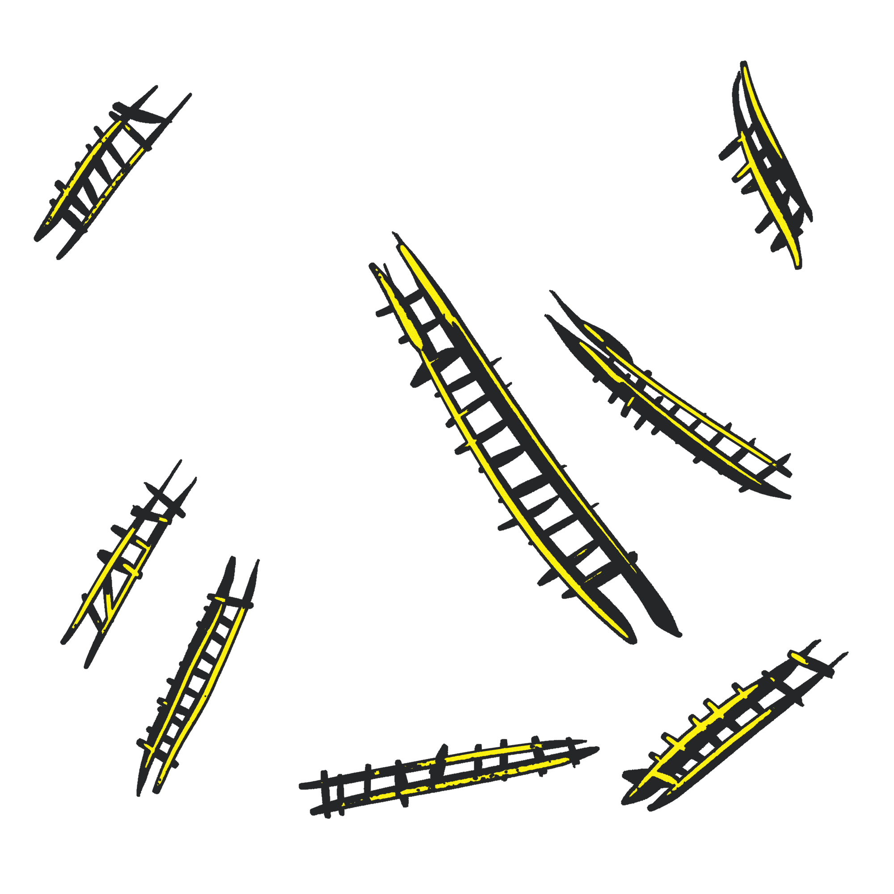
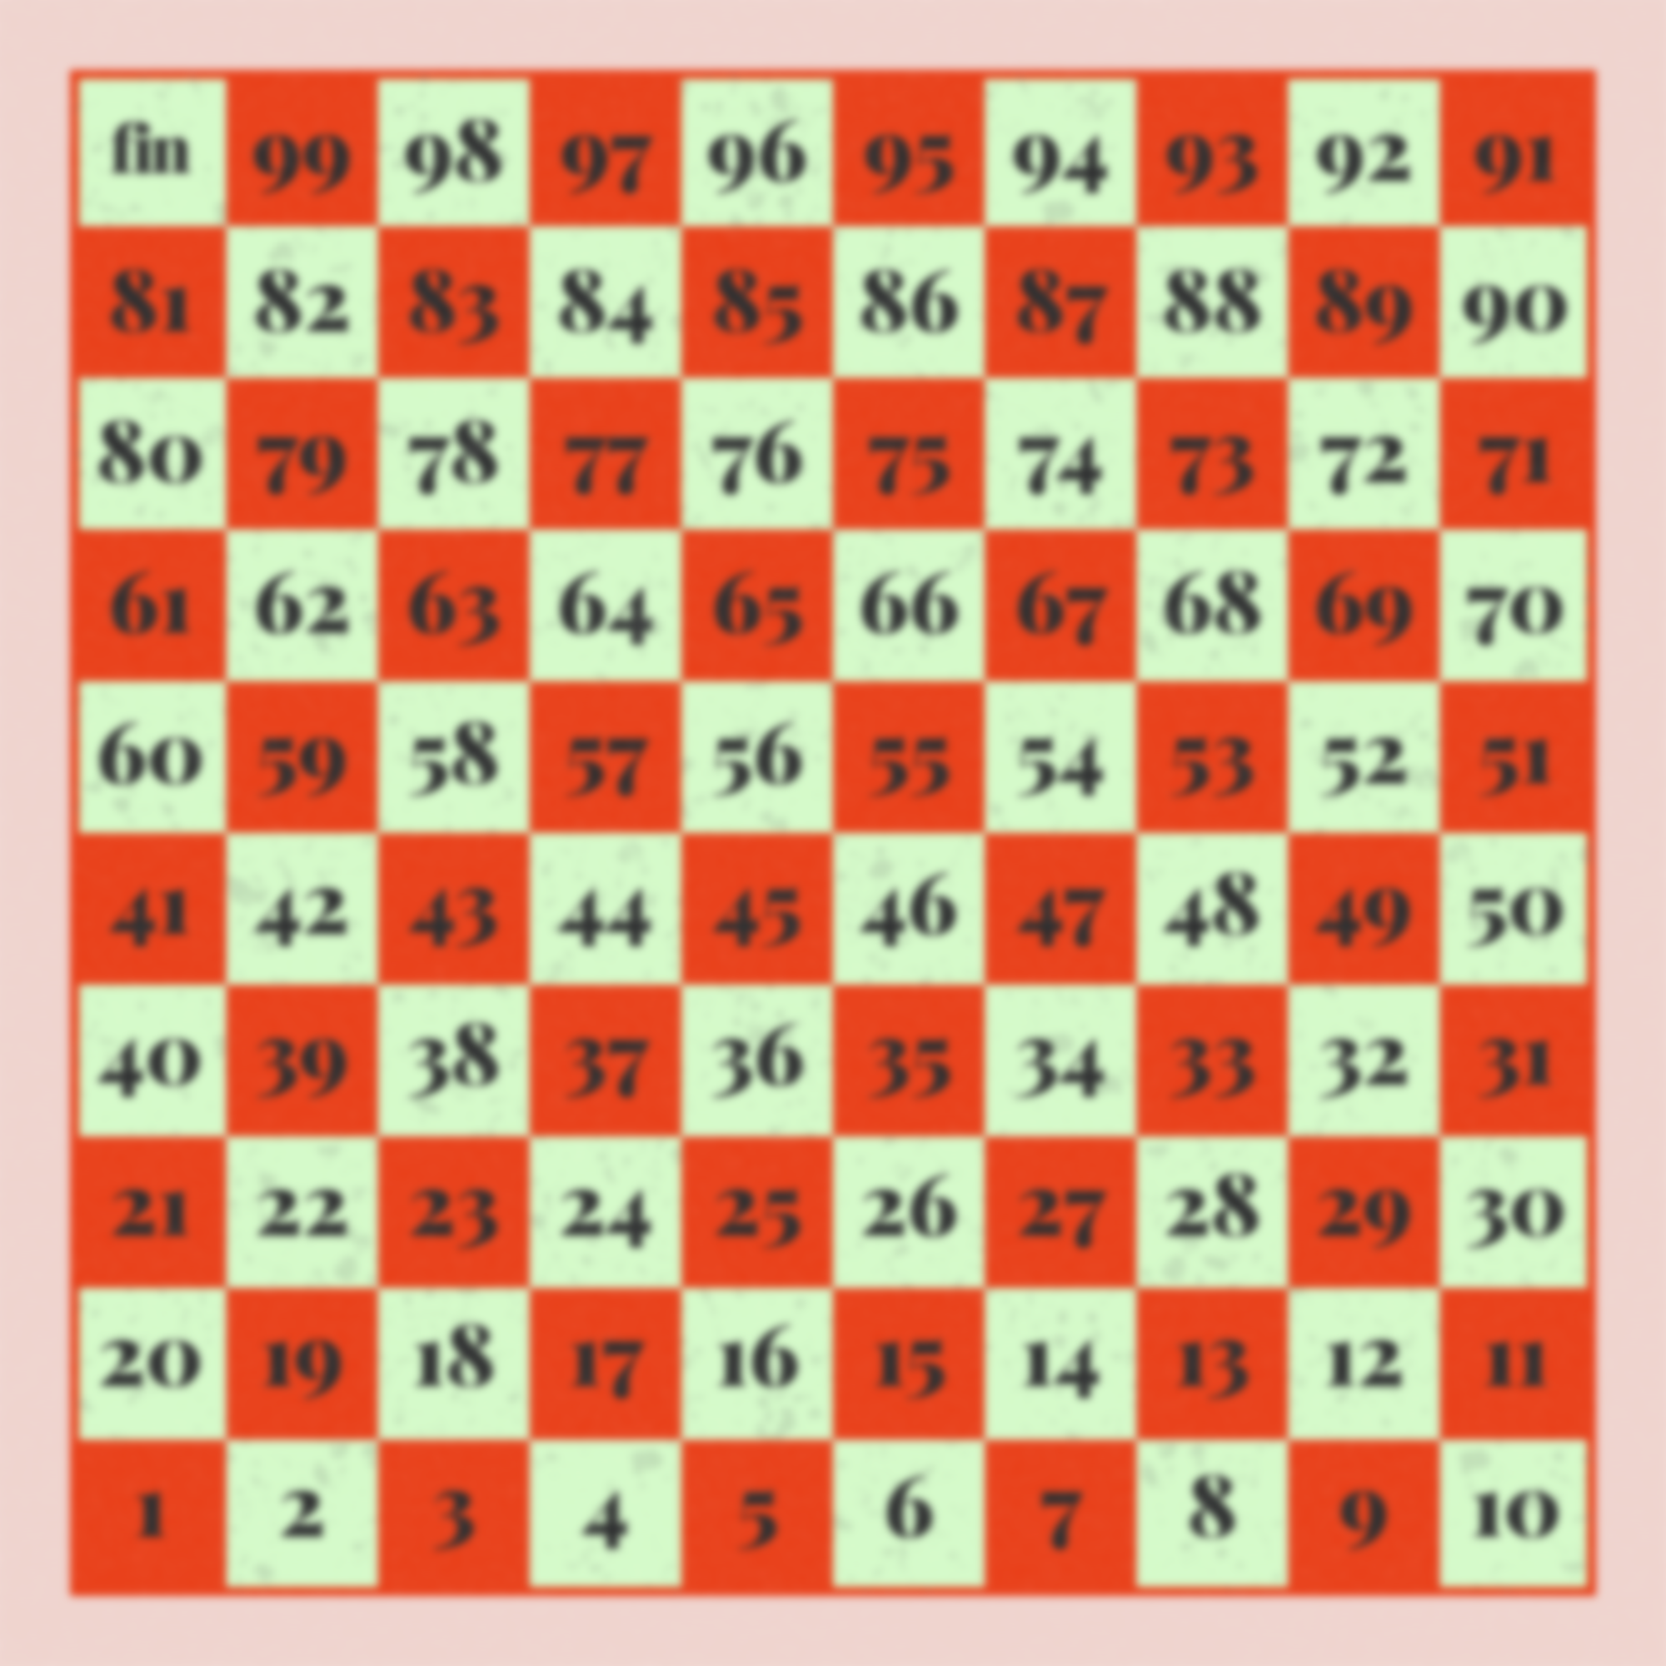
Python Project
Snakes and Ladders Re-imagined

Slide 2
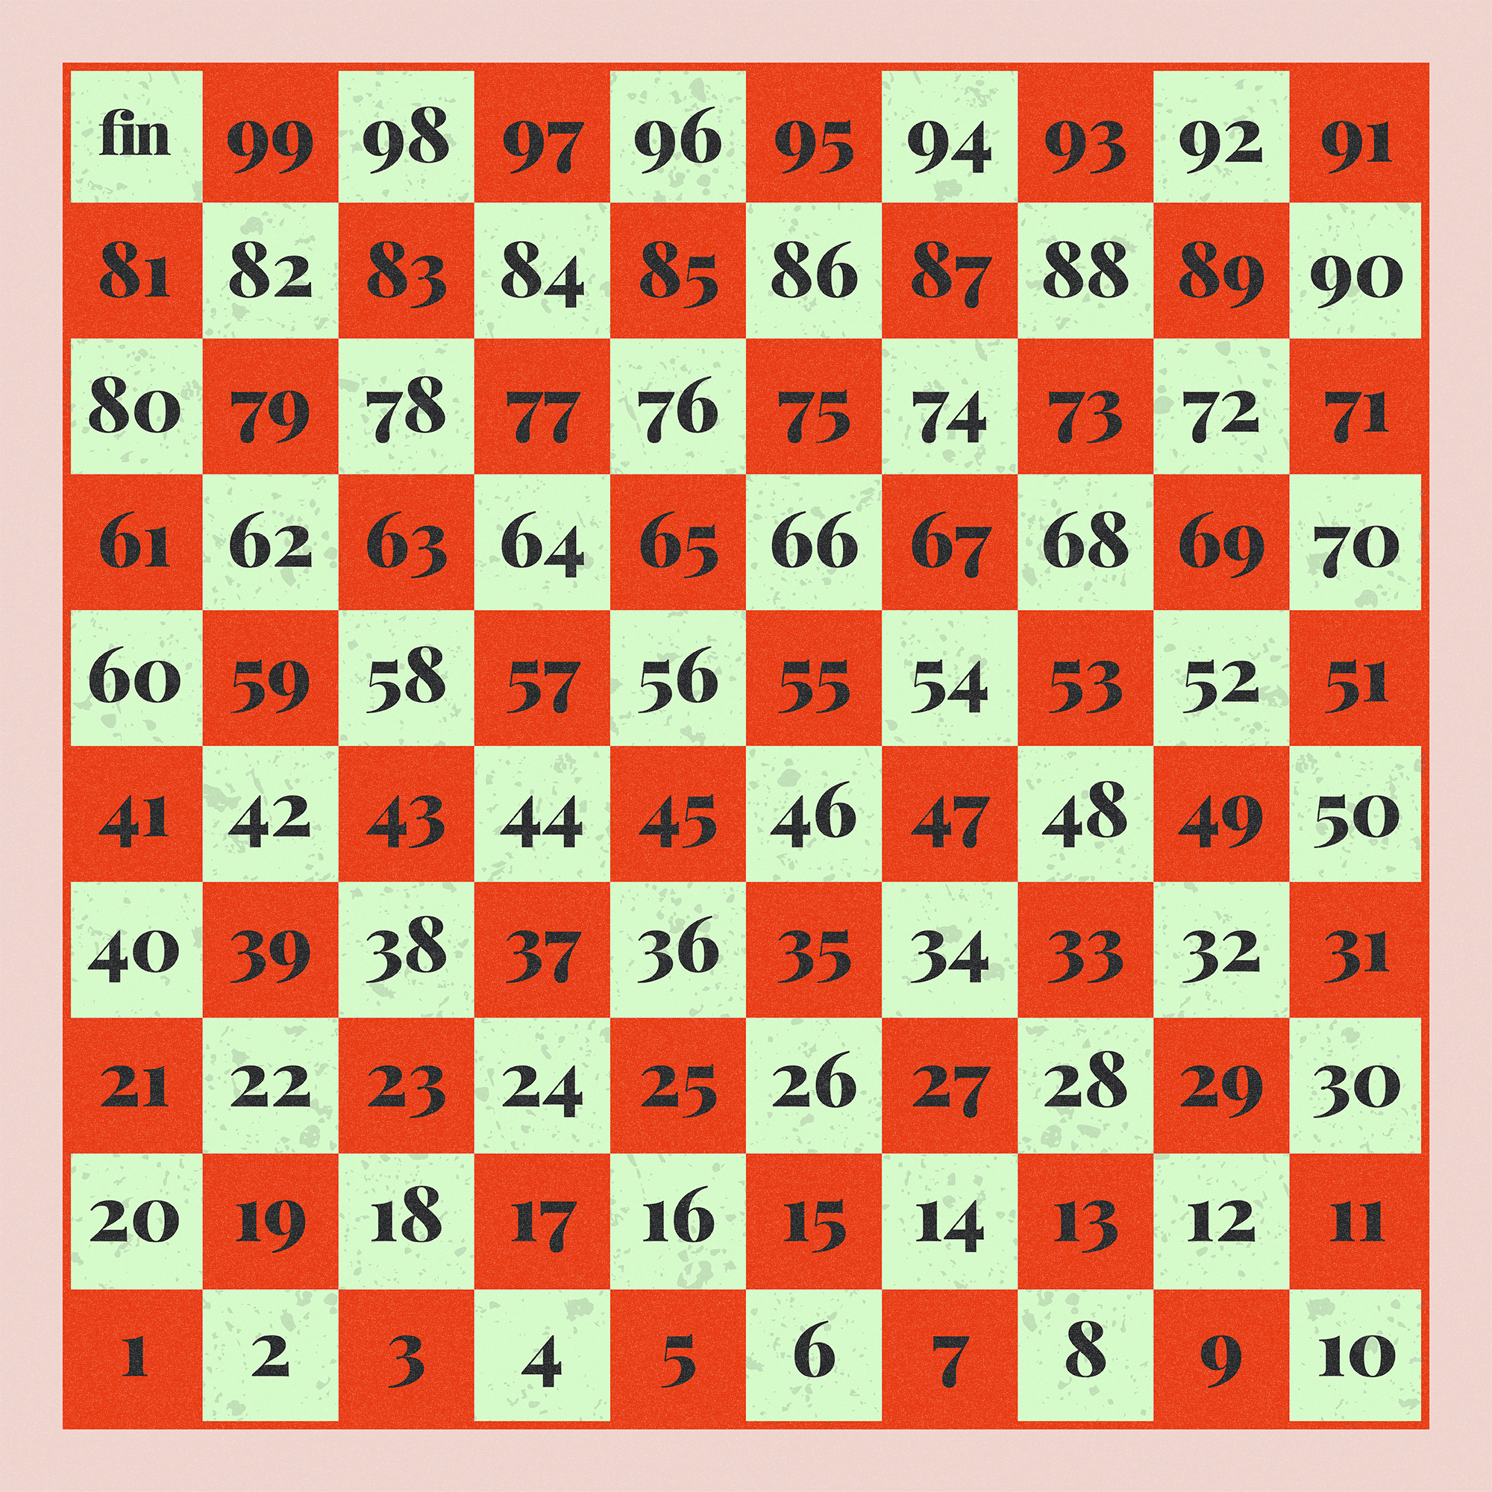
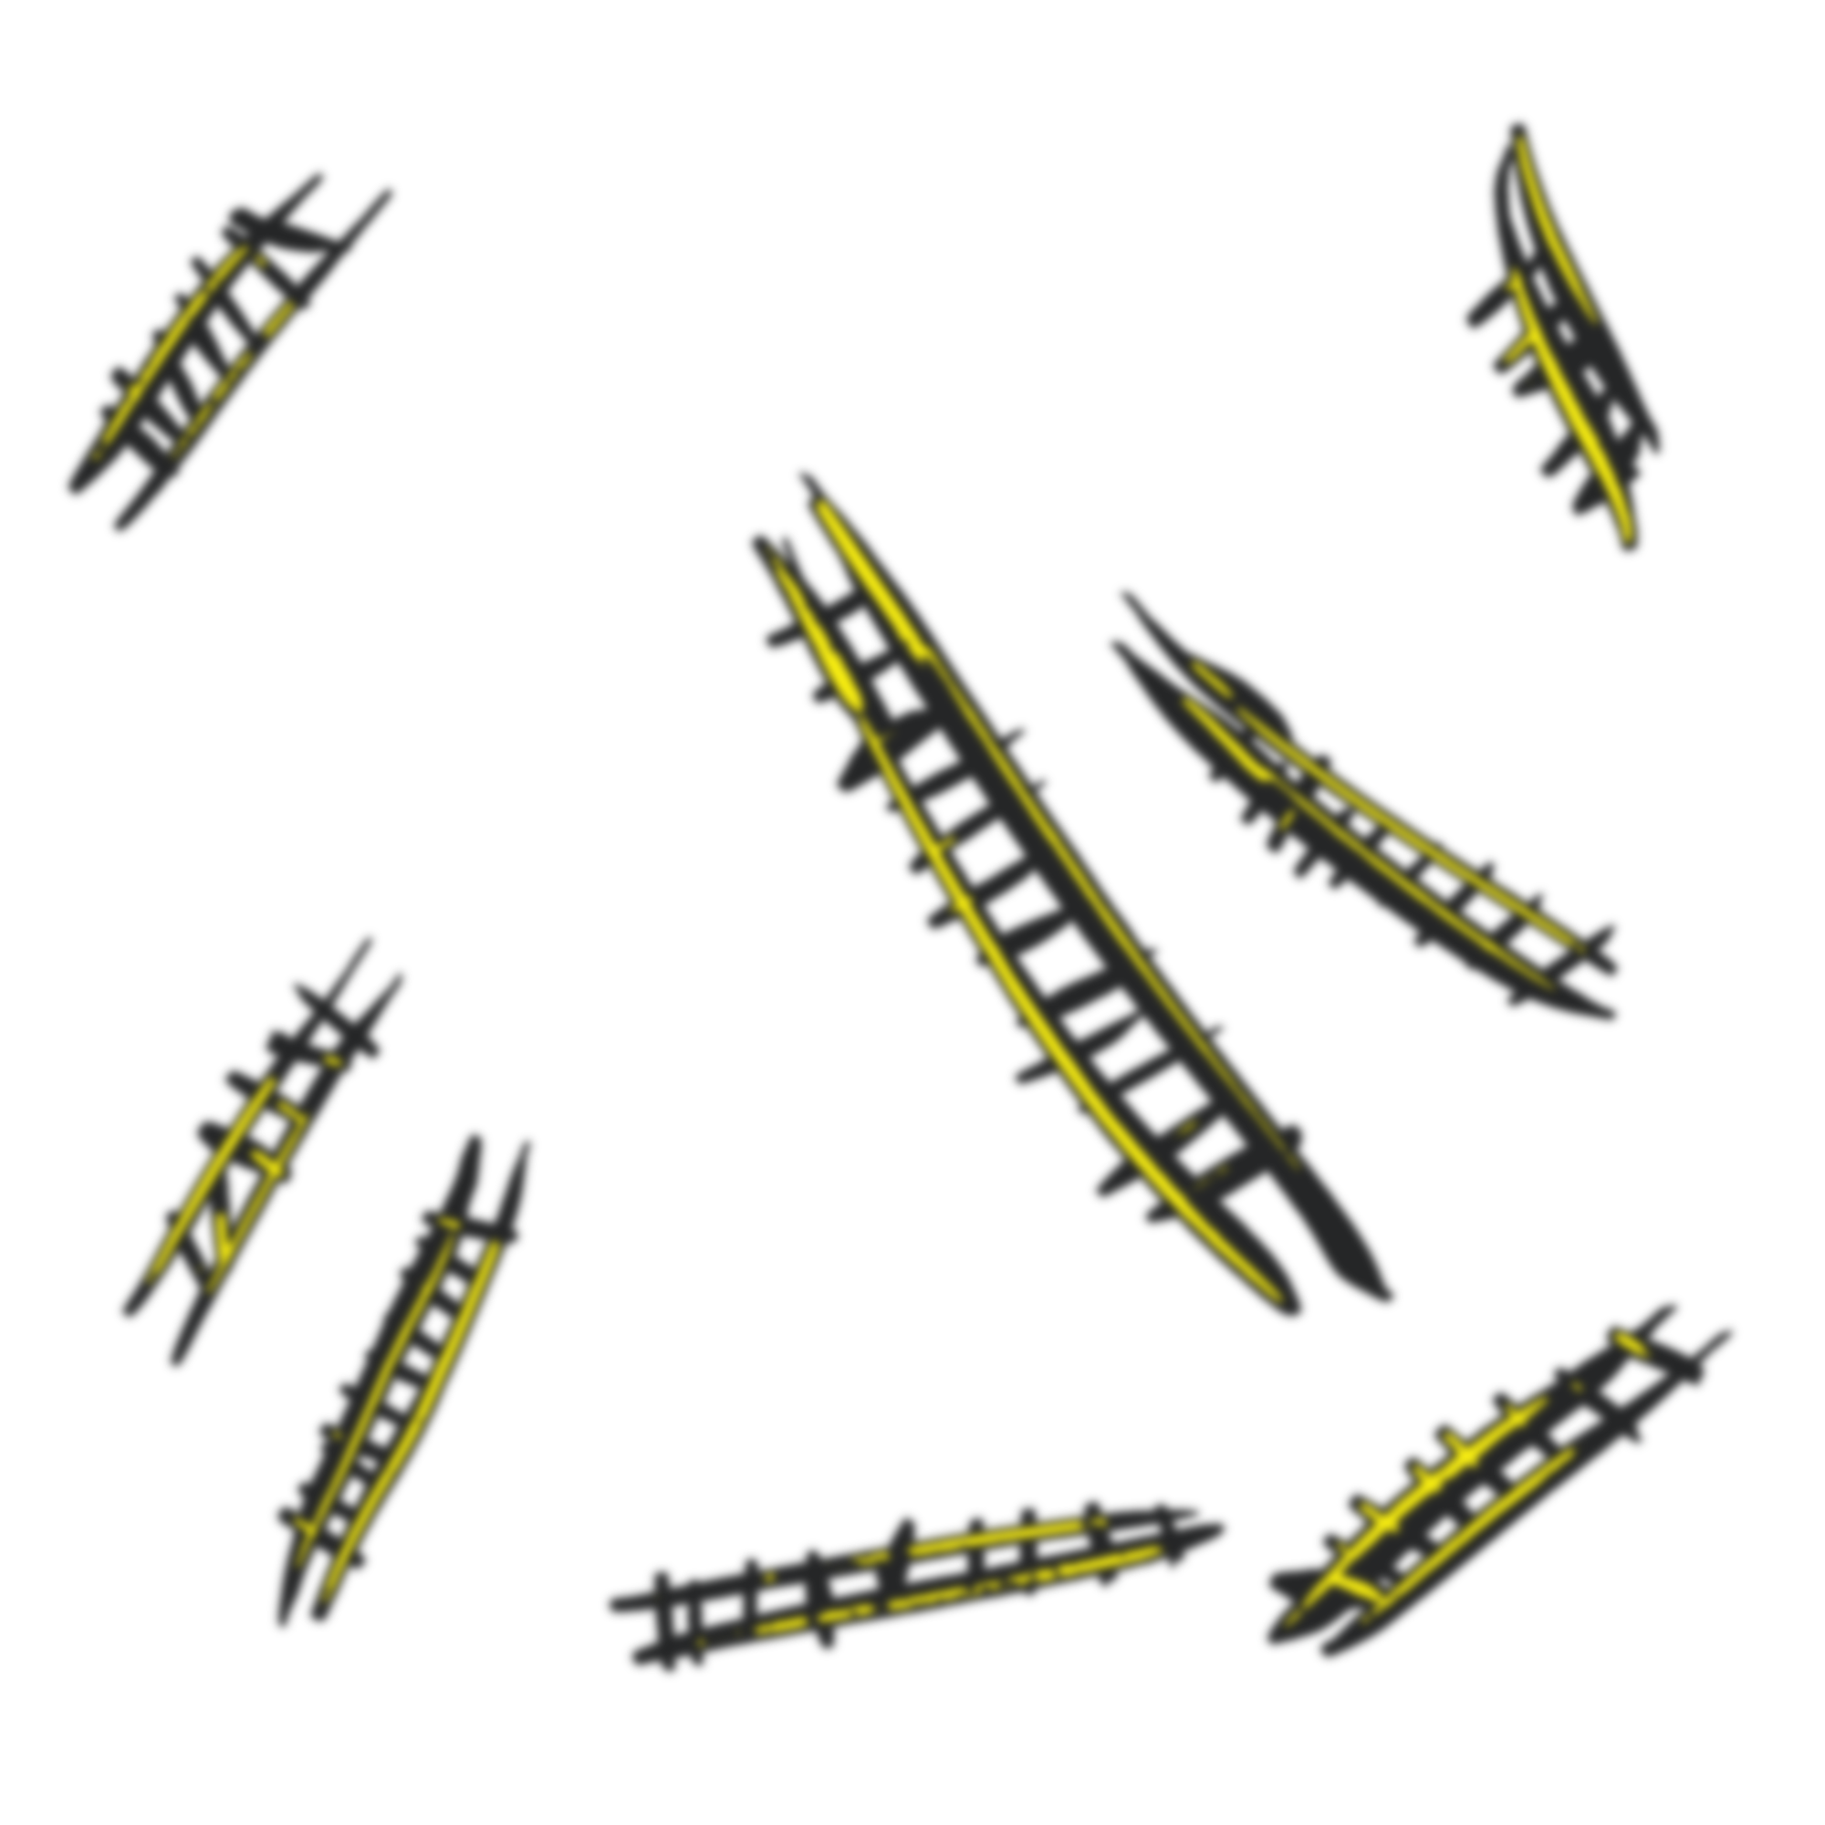
Python Project
Snakes and Ladders Re-imagined
Richa G, Rohan Raghu,
Satvik RK, Thanusha SM

Slide 3
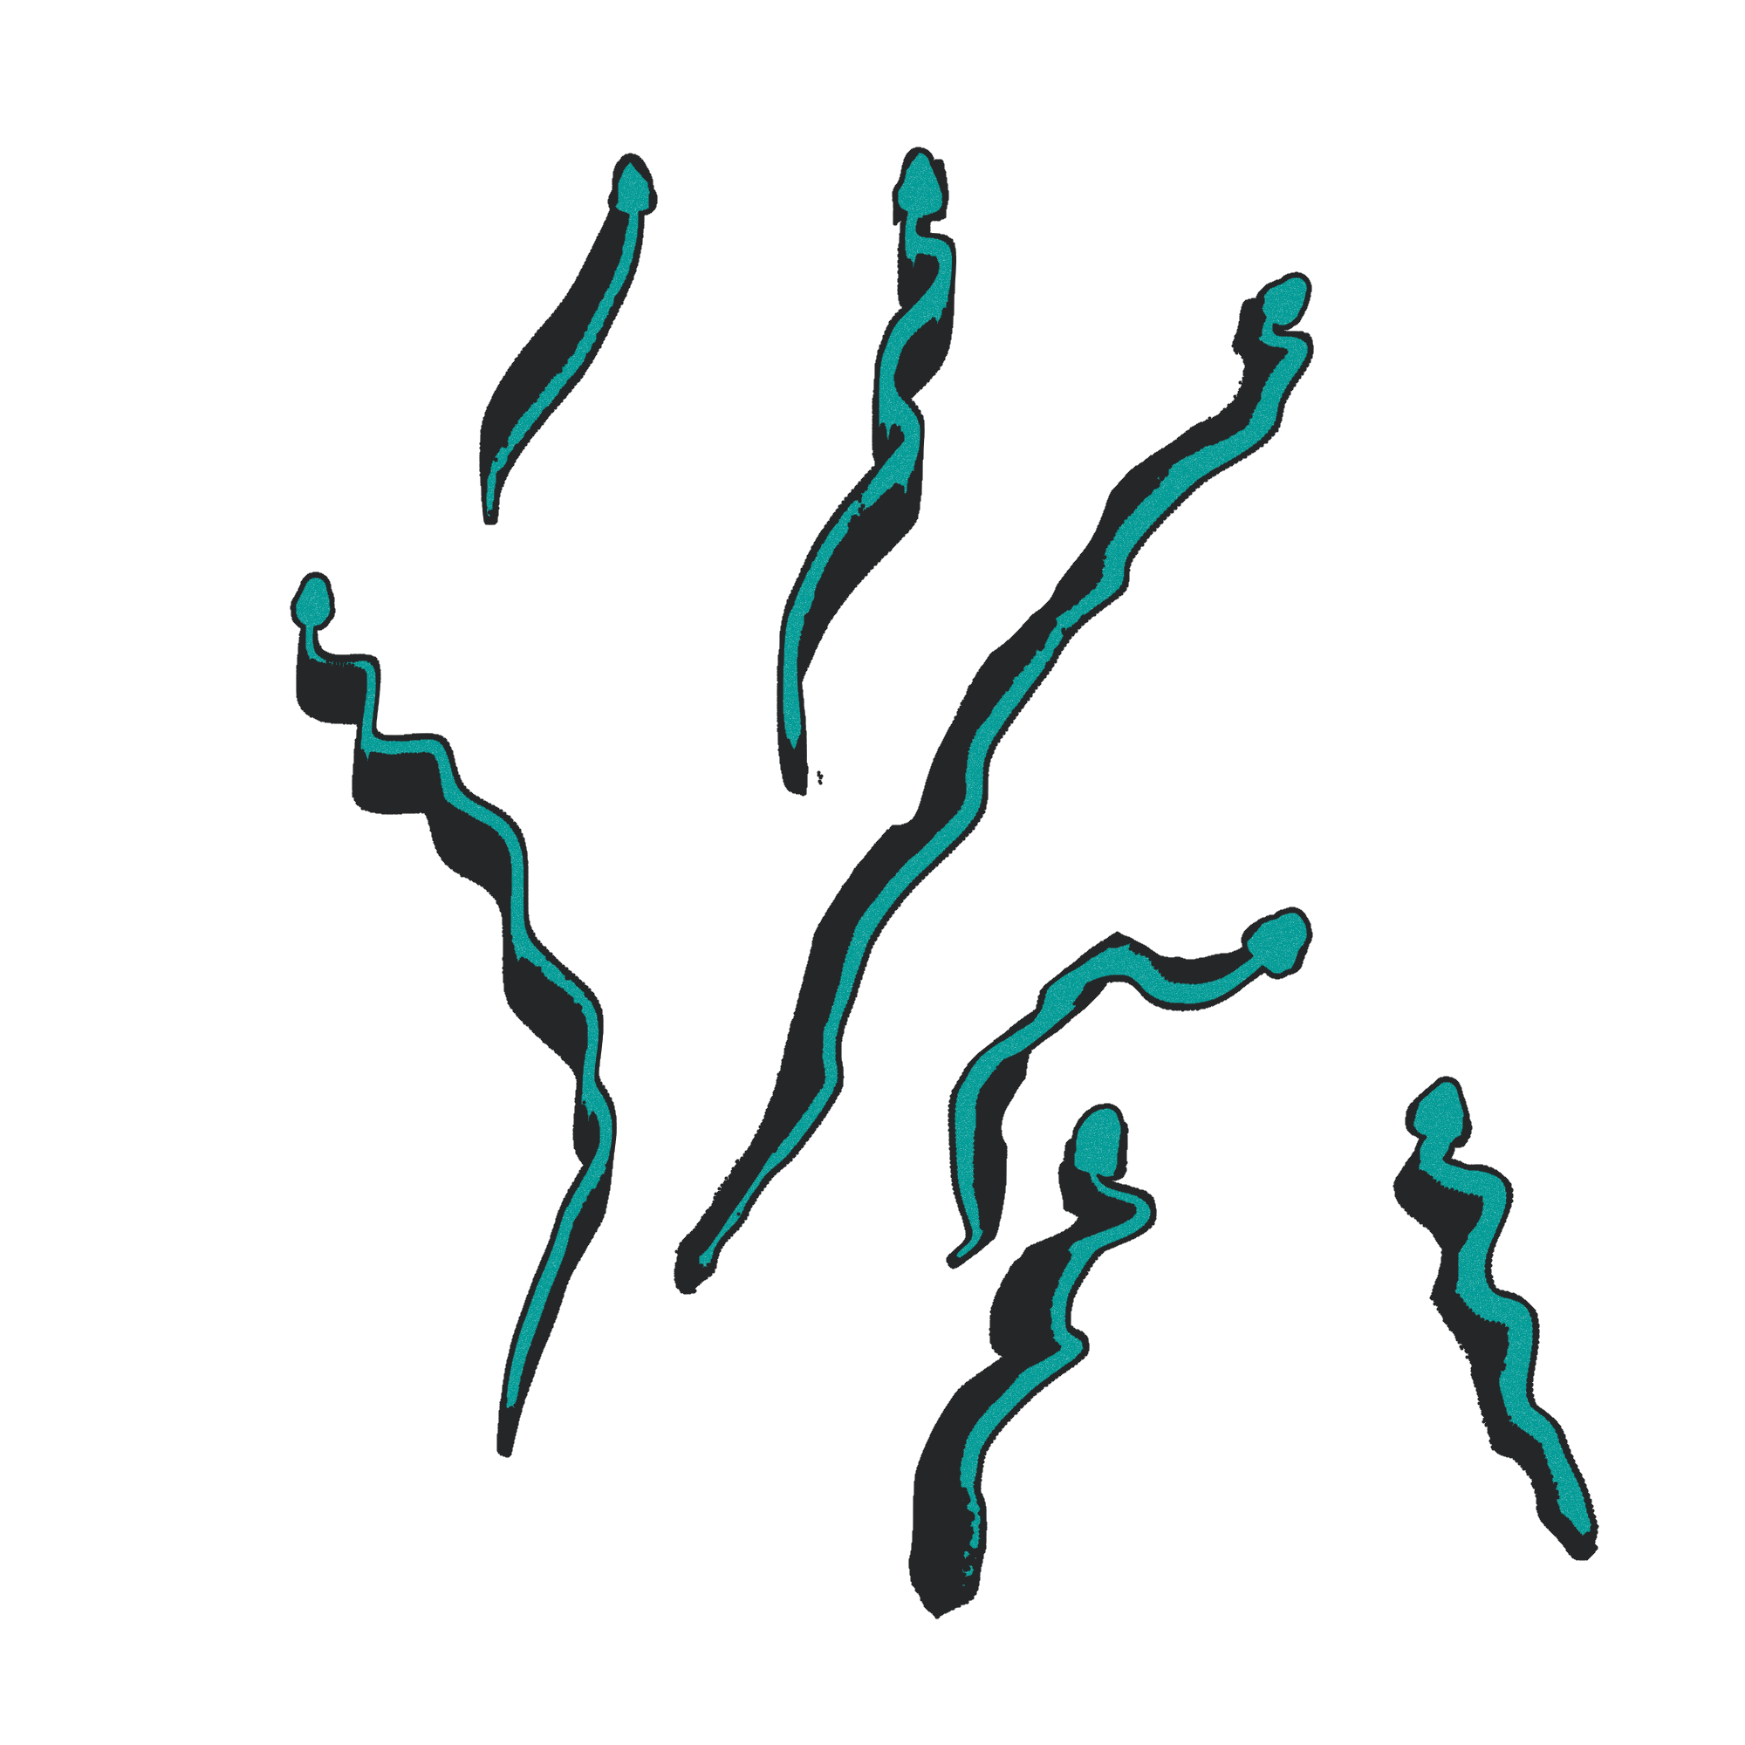
Python Project
Snakes and Ladders Re-imagined
Richa G, Rohan Raghu,
Satvik RK, Thanusha SM

Slide 4
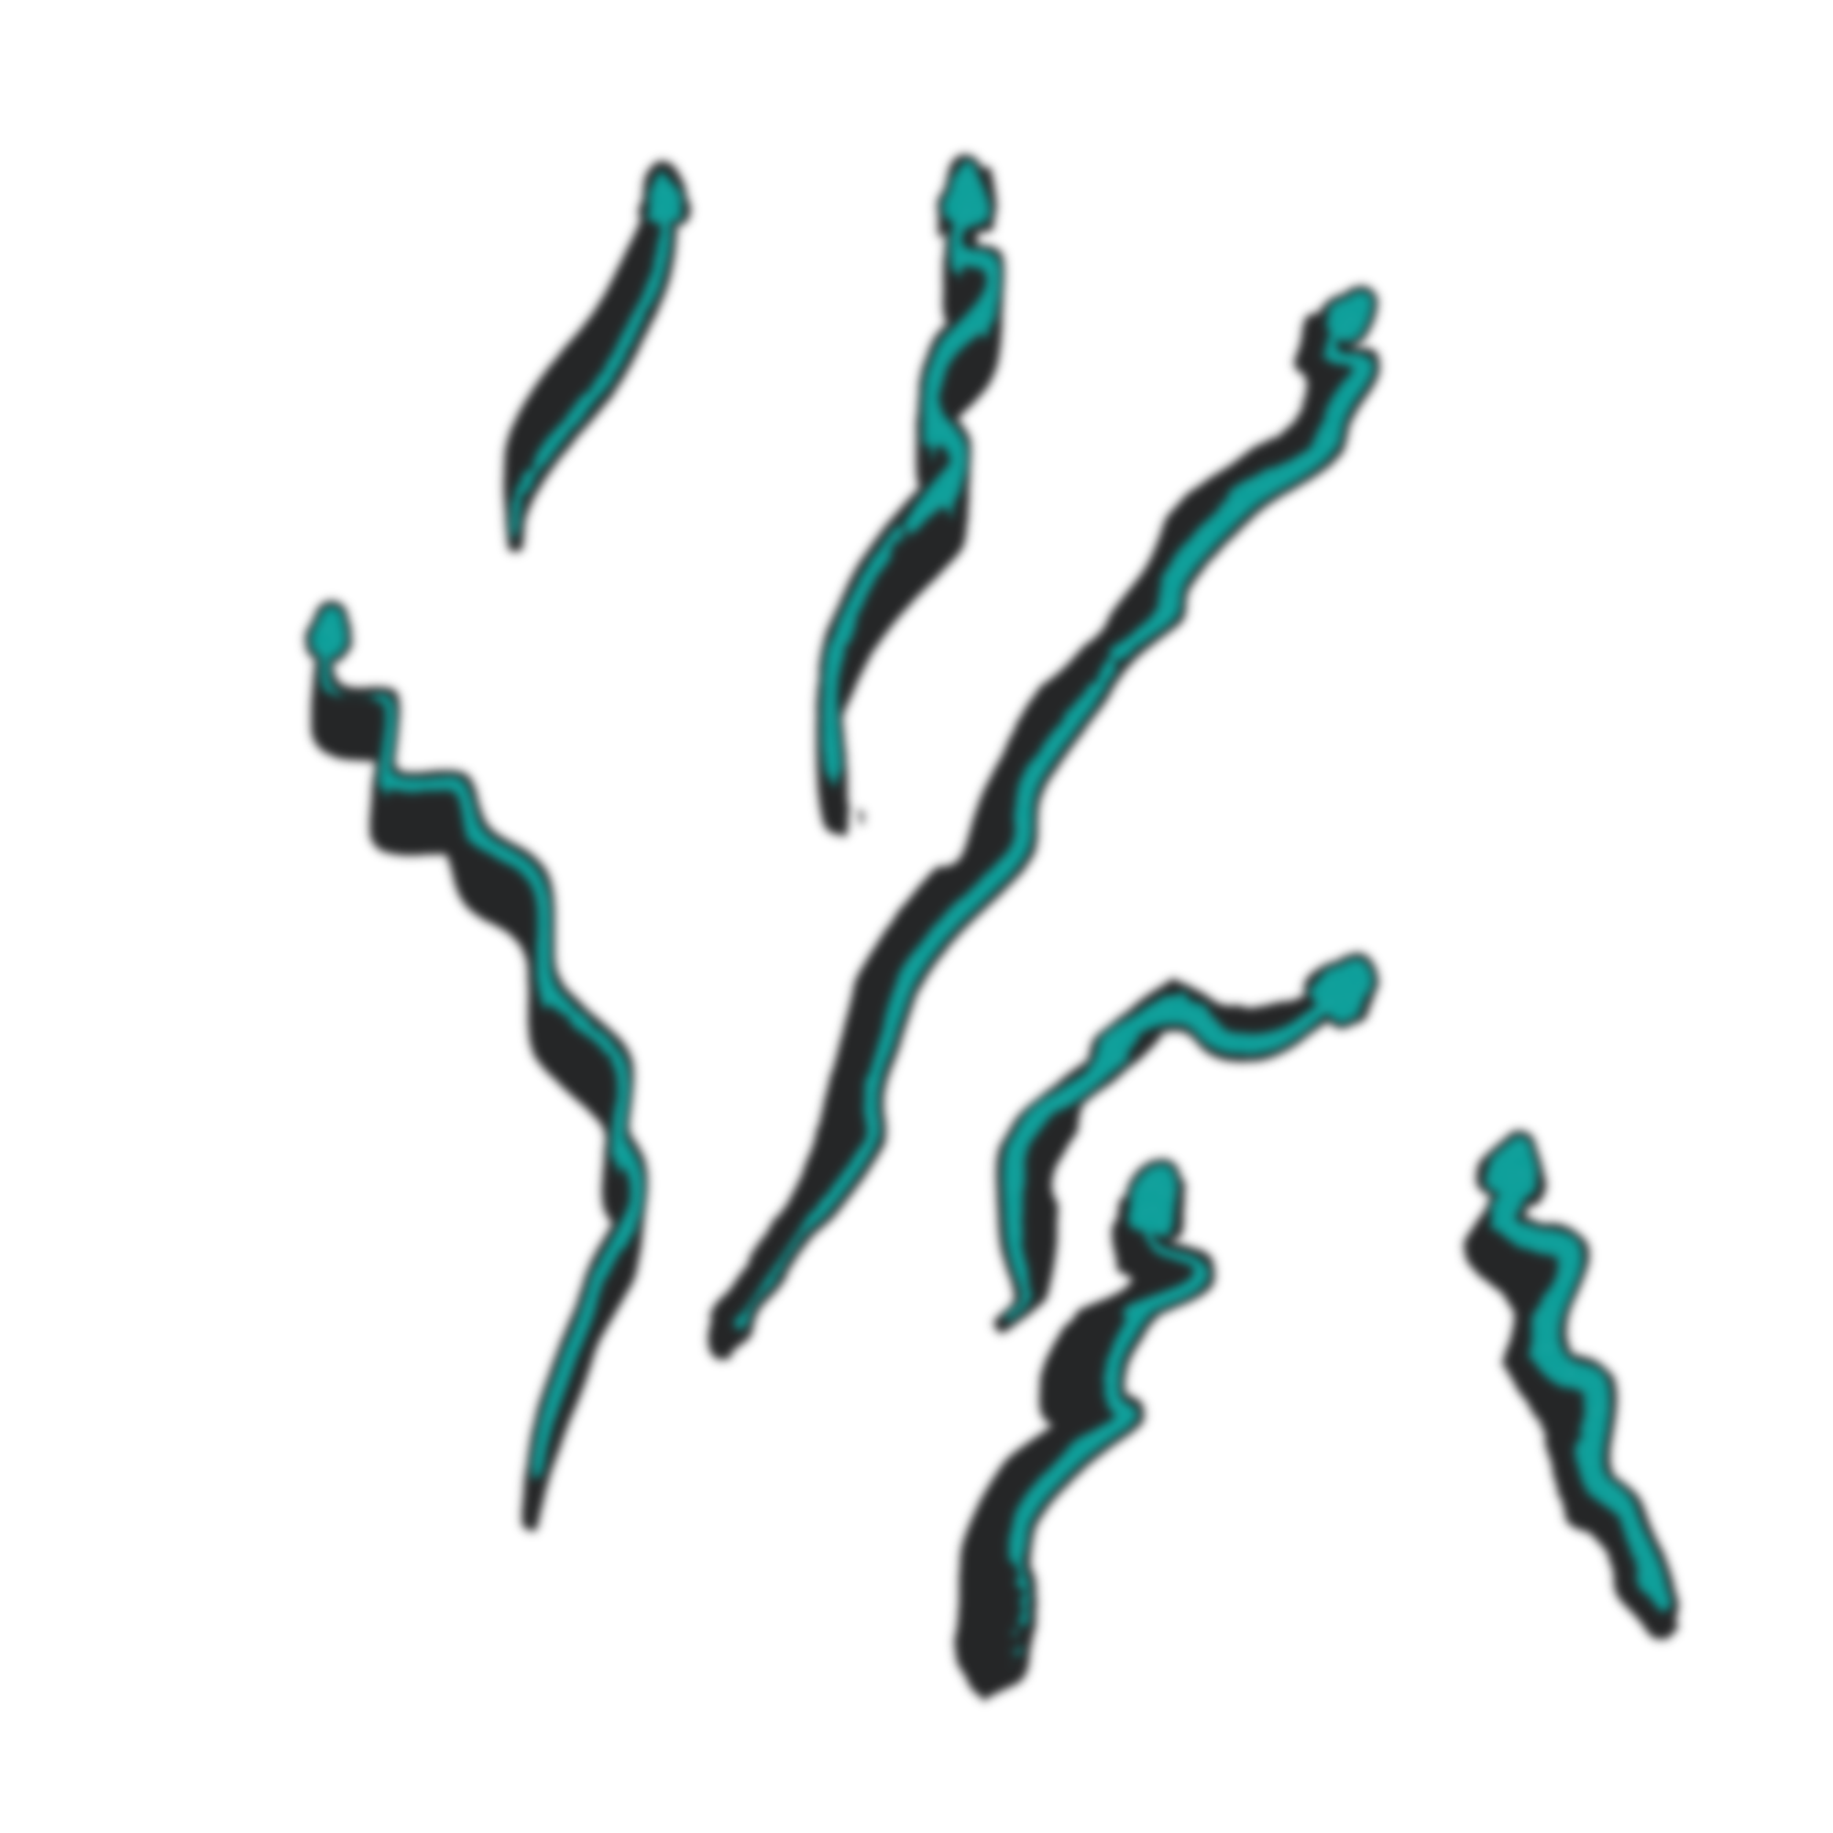
Python Project
Our Goal
Snakes and Ladders Re-imagined
Richa G, Rohan Raghu,
Satvik RK, Thanusha SM
As a team we want to change the traditional way of the old snakes and ladders and make it more interesting and fun to play.
We want this game to involve the player completely in the game rather than just rolling the dice and moving the pawns.

Slide 5
Our Goal
As a team we want to change the traditional way of the old snakes and ladders and make it more interesting and fun to play.
We want this game to involve the player completely in the game rather than just rolling the dice and moving the pawns.

Slide 6
Our Goal
Working of the Game
Richa G, Rohan Raghu,
Satvik RK, Thanusha SM
We start the game by rolling the die and moving our pawns up the virtual board.
If a player lands on a snake he/she gets a riddle and if the player fails to answer the riddle they will be sent a few positions behind and if they get it right they stay in the current position.
If the player lands in the ladder he/she gets a riddle and if they answer they move ahead in the board else they stay in the current position.
The player who manages to reach the end in the lowest time wins.

Slide 7
Working of the Game
We start the game by rolling the die and moving our pawns up the virtual board.
If a player lands on a snake he/she gets a riddle and if the player fails to answer the riddle they will be sent a few positions behind and if they get it right they stay in the current position.
If the player lands in the ladder he/she gets a riddle and if they answer they move ahead in the board else they stay in the current position.
The player who manages to reach the end in the lowest time wins.

Slide 8
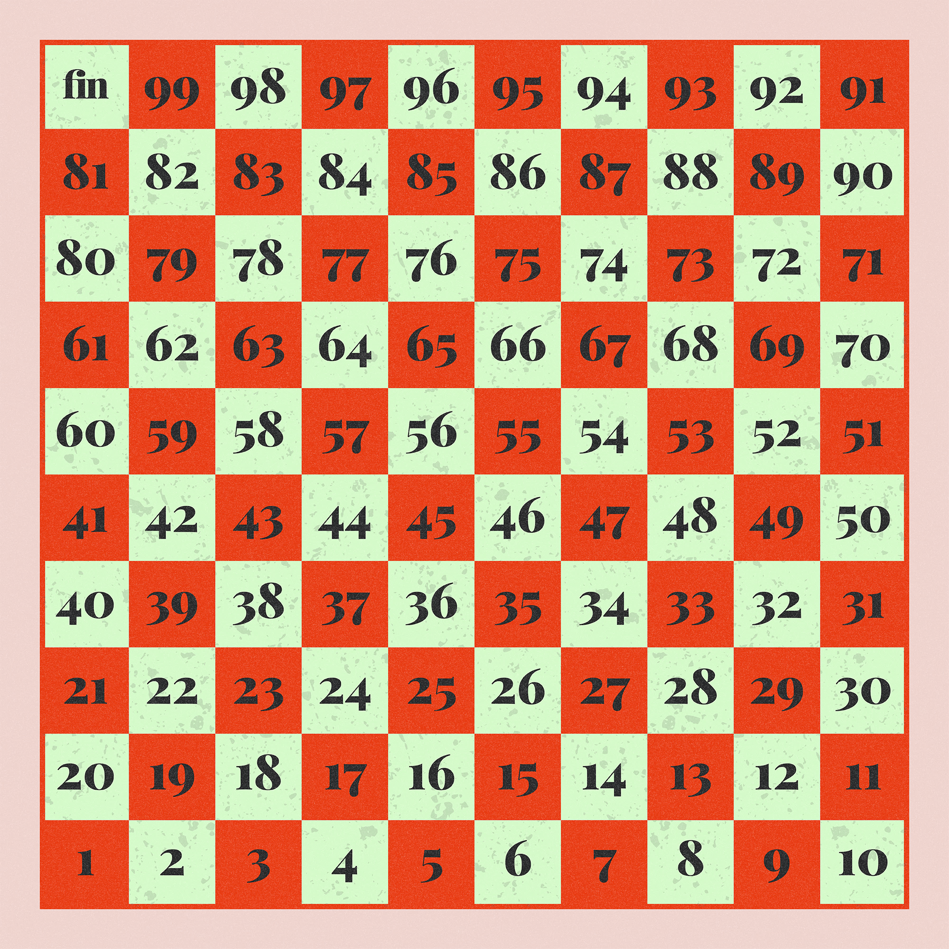
Working of the Game
We start the game by rolling the die and moving our pawns up the virtual board.
If a player lands on a snake he/she gets a riddle and if the player fails to answer the riddle they will be sent a few positions behind and if they get it right they stay in the current position.
If the player lands in the ladder he/she gets a riddle and if they answer they move ahead in the board else they stay in the current position.
The player who manages to reach the end in the lowest time wins.
The Board

Slide 9
Working of the Game
We start the game by rolling the die and moving our pawns up the virtual board.
If a player lands on a snake he/she gets a riddle and if the player fails to answer the riddle they will be sent a few positions behind and if they get it right they stay in the current position.
If the player lands in the ladder he/she gets a riddle and if they answer they move ahead in the board else they stay in the current position.
The player who manages to reach the end in the lowest time wins.
The Board

Slide 10
Working of the Game
The Code
import random
pos=1
score=0
ladders = {2: 38, 4: 14, 8: 30, 21: 42, 28: 76, 50: 67, 71: 92, 80: 99}
snakes = {32: 10, 34: 6, 48: 26, 62: 18, 88: 24, 95: 56, 97: 78}
def diceroll():
opt=input("Do you wish to roll the dice? (y/n): ")
if opt=="y":
return True
else:
return False
def board(pos):
print(" ----------------------------------------------------------- ")
for i in range (10, 0, -1):
print("|" , end="")
for j in range(10*i, (10*i) - 10, -1):
if j==pos:
print(" ", "•", end=" |")
elif j==100:
print("", j, end=" |")
elif j>9 and j<100: print(" ", j, end=" |")
elif j>0 and j<10:
print(" ", j, end=" |")
print("")
print(" ----------------------------------------------------------- ")
board(pos)
while pos<100:
if diceroll():
pos+=random.randint(1,6)
print("\nYour position is", pos)
if pos in snakes:
print("You have been bitten by a snake!")
pos=snakes[pos]
print("\nYour position is", pos)
elif pos in ladders:
print("You have climbed up a ladder!")
pos=ladders[pos]
print("\nYour position is", pos)
board(pos)
if pos>=100:
print("You win!")

Slide 11
Working of the Game
The Code
import random
pos=1
score=0
ladders = {2: 38, 4: 14, 8: 30, 21: 42, 28: 76, 50: 67, 71: 92, 80: 99}
snakes = {32: 10, 34: 6, 48: 26, 62: 18, 88: 24, 95: 56, 97: 78}
def diceroll():
opt=input("Do you wish to roll the dice? (y/n): ")
if opt=="y":
return True
else:
return False
def board(pos):
print(" ----------------------------------------------------------- ")
for i in range (10, 0, -1):
print("|" , end="")
for j in range(10*i, (10*i) - 10, -1):
if j==pos:
print(" ", "•", end=" |")
elif j==100:
print("", j, end=" |")
elif j>9 and j<100: print(" ", j, end=" |")
elif j>0 and j<10:
print(" ", j, end=" |")
print("")
print(" ----------------------------------------------------------- ")
board(pos)
while pos<100:
if diceroll():
pos+=random.randint(1,6)
print("\nYour position is", pos)
if pos in snakes:
print("You have been bitten by a snake!")
pos=snakes[pos]
print("\nYour position is", pos)
elif pos in ladders:
print("You have climbed up a ladder!")
pos=ladders[pos]
print("\nYour position is", pos)
board(pos)
if pos>=100:
print("You win!")
import tkinter as tk
from PIL import ImageTk, Image
root=tk.Tk()
root.geometry("1920x1080")
root.title("Snakes & Ladders")
F1=tk.Frame(root, width=1000, height=1000, relief='raised')
F1.place(x=0, y=0)
bg=Image.open("finalboard.png")
resized_bg= bg.resize((1000,1000), Image.LANCZOS)
new_bg= ImageTk.PhotoImage(resized_bg)
bglbl=tk.Label(F1, image=new_bg)
bglbl.place(x=0, y=0)
b1=tk.Button(root, text="Rules", height=3, width=20, fg="#BABABA", bg="#EEEEEE", font=("Poppins", "14", "bold"), relief="flat")
b1.place(x=1200, y=400)

Slide 12
Working of the Game
import tkinter as tk
from tkinter import *
import random
from PIL import ImageTk, Image
from win32 import win32gui
from win32 import win32con
from win32 import win32api
import time
#Initialise main window
root=tk.Tk()
root.geometry("1920x1080")
root.title("Snakes & Ladders")
root.configure(bg="#EED2CC")
#Create frame to place elements inside of
F1=tk.Frame(root, width=1000, height=1000, relief='raised')
F1.place(x=0, y=0)
#Add background image after resizing
bg=Image.open("finalboard.png")
resized_bg= bg.resize((1000,1000), Image.LANCZOS)
new_bg= ImageTk.PhotoImage(resized_bg)
bglbl=tk.Label(F1, image=new_bg)
bglbl.place(x=0, y=0)
#Player Pawn
pawn=tk.Canvas(root,width=50, height=50,)
pawn.create_rectangle(0,0,100,100,fill='#039B96')
pawn.place(x=70, y=70)
#Index of each position
d={}
L=[[100, 99, 98, 97, 96, 95, 94, 93, 92, 91], [81, 82, 83, 84, 85, 86, 87, 88, 89, 90], [80, 79, 78, 77, 76, 75, 74, 73, 72, 71], [61, 62, 63, 64, 65, 66, 67, 68, 69, 70], [60, 59, 58, 57, 56, 55, 54, 53, 52, 51], [41, 42, 43, 44, 45, 46, 47, 48, 49, 50], [40, 39, 38, 37, 36, 35, 34, 33, 32, 31], [21, 22, 23, 24, 25, 26, 27, 28, 29, 30], [20, 19, 18, 17, 16, 15, 14, 13, 12, 11], [1, 2, 3, 4, 5, 6, 7, 8, 9, 10]]
y=70
for i in L:
x=70
for j in i:
d[j]=(x, y)
x+=90
y+=90
begin = time.time()
def movepawn(pos):
pawn.place(x=d[pos][0], y=d[pos][1])
def rolldice():
global pos
dice=random.randint(1, 6)
pos+=dice
if pos>=100:
win()
movepawn(pos)
dicelabel=tk.Label(root, text= "You rolled a "+str(dice) + "!", font=("Playfair Display",14)).place(x=1000, y=144)
def win(): #Fix opening of multiple windows
win3 = tk.Tk()
win3.geometry("350x120")
win3.grid()
labelwin=tk.Label(win3, text= "You win!", font=("Playfair Display",14)).pack()
labeltime=tk.Label(win3, text= "Time taken: "+ text1, font=("Playfair Display",14)).pack()
exit1=tk.Button(win3, text= "Exit Application", font=("Playfair Display",14), command=close, bg="#a52a2a", fg='white').pack()
#Exit Window
def close():
win2 = tk.Tk()
win2.geometry("350x120")
win2.grid()
def end():
root.destroy()
win2.destroy()
def cont():
win2.destroy()
label=tk.Label(win2, text= "Are you sure you want to exit?", font=("Playfair Display",14)).grid(column=0, row=0)
yes=tk.Button(win2, text= "Yes", font=("Playfair Display",14), command=end, bg="#cdcdcd", fg='black').grid(column=1, row=1)
no=tk.Button(win2, text= "No", font=("Playfair Display",14), command=cont, bg="#cdcdcd", fg='black').grid(column=2, row=1)
pos=1
movepawn(1)
'''
if pos>=100:
end=time.time()
time = float(round(time,3))
timetaken = ""
if time >= 60.999:
newTime = time/60
timetaken += ("The final time was " + str(newTime) + " minutes")
else:
timetaken += ("The final time was " + str(time) + " seconds")
print(timetaken)'''
exit1=tk.Button(root, text= "Exit Application", font=("Playfair Display",14), command=close, bg="#a52a2a", fg='white').place(x=1000, y=44)
dice1=tk.Button(root, text= "Roll the Dice", font=("Playfair Display",14), command=rolldice, bg="#a52a2a", fg='white').place(x=1000, y=94)
root.mainloop()
The Code

Slide 13
import tkinter as tk
from tkinter import *
import random
from PIL import ImageTk, Image
from win32 import win32gui
from win32 import win32con
from win32 import win32api
import time
#Initialise main window
root=tk.Tk()
root.geometry("1920x1080")
root.title("Snakes & Ladders")
root.configure(bg="#EED2CC")
#Create frame to place elements inside of
F1=tk.Frame(root, width=1000, height=1000, relief='raised')
F1.place(x=0, y=0)
#Add background image after resizing
bg=Image.open("finalboard.png")
resized_bg= bg.resize((1000,1000), Image.LANCZOS)
new_bg= ImageTk.PhotoImage(resized_bg)
bglbl=tk.Label(F1, image=new_bg)
bglbl.place(x=0, y=0)
#Player Pawn
pawn=tk.Canvas(root,width=50, height=50,)
pawn.create_rectangle(0,0,100,100,fill='#039B96')
pawn.place(x=70, y=70)
#Index of each position
d={}
L=[[100, 99, 98, 97, 96, 95, 94, 93, 92, 91], [81, 82, 83, 84, 85, 86, 87, 88, 89, 90], [80, 79, 78, 77, 76, 75, 74, 73, 72, 71], [61, 62, 63, 64, 65, 66, 67, 68, 69, 70], [60, 59, 58, 57, 56, 55, 54, 53, 52, 51], [41, 42, 43, 44, 45, 46, 47, 48, 49, 50], [40, 39, 38, 37, 36, 35, 34, 33, 32, 31], [21, 22, 23, 24, 25, 26, 27, 28, 29, 30], [20, 19, 18, 17, 16, 15, 14, 13, 12, 11], [1, 2, 3, 4, 5, 6, 7, 8, 9, 10]]
y=70
for i in L:
x=70
for j in i:
d[j]=(x, y)
x+=90
y+=90
begin = time.time()
def movepawn(pos):
pawn.place(x=d[pos][0], y=d[pos][1])
def rolldice():
global pos
dice=random.randint(1, 6)
pos+=dice
if pos>=100:
win()
movepawn(pos)
dicelabel=tk.Label(root, text= "You rolled a "+str(dice) + "!", font=("Playfair Display",14)).place(x=1000, y=144)
def win(): #Fix opening of multiple windows
win3 = tk.Tk()
win3.geometry("350x120")
win3.grid()
labelwin=tk.Label(win3, text= "You win!", font=("Playfair Display",14)).pack()
labeltime=tk.Label(win3, text= "Time taken: "+ text1, font=("Playfair Display",14)).pack()
exit1=tk.Button(win3, text= "Exit Application", font=("Playfair Display",14), command=close, bg="#a52a2a", fg='white').pack()
#Exit Window
def close():
win2 = tk.Tk()
win2.geometry("350x120")
win2.grid()
def end():
root.destroy()
win2.destroy()
def cont():
win2.destroy()
label=tk.Label(win2, text= "Are you sure you want to exit?", font=("Playfair Display",14)).grid(column=0, row=0)
yes=tk.Button(win2, text= "Yes", font=("Playfair Display",14), command=end, bg="#cdcdcd", fg='black').grid(column=1, row=1)
no=tk.Button(win2, text= "No", font=("Playfair Display",14), command=cont, bg="#cdcdcd", fg='black').grid(column=2, row=1)
pos=1
movepawn(1)
'''
if pos>=100:
end=time.time()
time = float(round(time,3))
timetaken = ""
if time >= 60.999:
newTime = time/60
timetaken += ("The final time was " + str(newTime) + " minutes")
else:
timetaken += ("The final time was " + str(time) + " seconds")
print(timetaken)'''
exit1=tk.Button(root, text= "Exit Application", font=("Playfair Display",14), command=close, bg="#a52a2a", fg='white').place(x=1000, y=44)
dice1=tk.Button(root, text= "Roll the Dice", font=("Playfair Display",14), command=rolldice, bg="#a52a2a", fg='white').place(x=1000, y=94)
root.mainloop()
Working of the Game
The Code

Slide 14
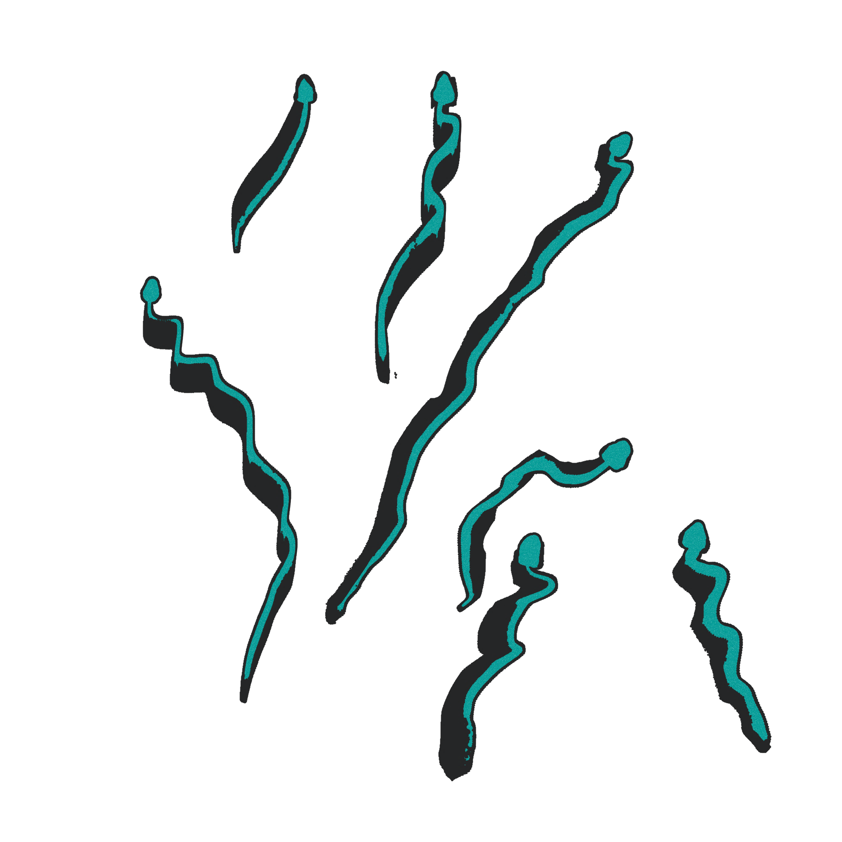
Python Project
The End
Snakes and Ladders Re-imagined
Richa G, Rohan Raghu,
Satvik RK, Thanusha SM
As a team we want to change the traditional way of the old snakes and ladders and make it more interesting and fun to play.
We want this game to involve the player completely in the game rather than just rolling the dice and moving the pawns.

